Slide 1
Architecting for Modern Cloud Applications

Slide 2
“Traditional” Applications
Client
Request
Response
Front-End
Application Logic
(Relational) Database
Notes:
What is a Modern App? To answer that question, let’s look at what a “Traditional” application is first. Most applications these days use architectures that we’re designed roughly 2 decades ago. These are multi-tier applications using a request/response model. The client, a browser or some other client talks to a front-end, mostly web servers. These pass on the request to the Application Logic tier, which in turn talks to a database. This is typically a relational database. The response follows the opposite route. Of course there are variations on this basic architecture, but many applications are designed using similar principles.

Slide 3
Typical Characteristics of Traditional Apps
Real-time request/response
Synchronous
Always connected
Transactional
Scale-Up
Failover
Notes:
Traditional applications typically take a real-time request/response approach, and as such synchronous communication. This ties into the way our brain works. We think in cause and effect in a synchronous way. That also usually means the client is always connected, because it needs to receive results synchronously. When we update data in traditional applications, that always happens in a transactional process. In fact, transactions are even involved when retrieving data. That’s just how a relational database works. Transactions aren’t bad in itself, but they do limit scalability, and cause an application to only scale-up rather than scaling out. This also implies the database needs to be in a failover setup. Also, these applications often assume you are connected to the network when you use the application, either with a client or the browser.
In a mobile first, cloud first world traditional architectures like this don’t work very well. The number of clients has exploded with mobile devices and more people around the world having internet access, and applications that were created under traditional architectures can’t handle that. We see that around us on a regular basis, like when tickets became available for Star Wars: The Force Awakens. The reservation systems of several cinema chains broke under the load.

Slide 4
Modern Cloud Apps
Devices, Browsers, Things etc.
Response
Receive
Distribute
Process
Analyze
Store
Notes:
Modern Cloud Apps have a different approach and are built with internet scale in mind. Traditional applications get their base architecture from an era in which scale meant several thousand users, not potentially millions of users. Modern Cloud Apps need to be able to deal with disconnected devices, scale up to many concurrent users, and may need to be available anywhere in the world. To deal with this, you can think of a Modern Cloud Apps having several logical functions:
<click>Receive, to deal with requests from devices.
<click>Process, to process incoming data through the Receive function.
<click>Store, to store processed data.
<click>Analyze, to analyze data that has been stored.
<click>Distribute, to bring data stored and potentially analyzed to the clients, the data can be distributed to caches and such. Like data analysis this is optional depending on the use case, but by designing with this is mind, you can cache later.
<click>Response, send a response to the client.
You can think of this as a circle, starting with the client and eventually coming back to the client in a clockwise manner.
Your application or specific functions in an application may not need al the logical blocks, so you can skip steps in the process. For instance, a device just requesting data can skip the process, store, analyze and distribute step, and just send a response based on already distributed data.

Slide 5
Modern Cloud Apps Characteristics
Asynchronous / Queued
Eventual Consistency
Microservices
Command & Query Pattern
Polyglot Persistence
Notes:
One of the key aspects of Modern Cloud Apps is asynchronous processing of anything that can’t be handled with a very low latency response. If it can’t be processed immediately a queue is used to throttle the incoming load to back-end services. You may be familiar with the concept of microservices, which breaks up functionality into small, specialized services that can be reused across applications. Microservices are great, but the communication with a high number of microservices can incur latency. This is why asynchronous / queued communication is important for scaling.
A common way top deal with asynchronous operation is using the Command & Query pattern, which splits commands that change data from commands that retrieve data. By using this pattern, your application makes changes using a command and gets the result by querying for it separately. That may involve querying, but notifications to a client are also an option.
Instead of using transactions, Modern Cloud Apps mostly use principles around Eventual Consistency. This means your application needs to be able to deal with inconsistencies between different parts of the system, potentially half way across the world.
Another important aspect is Polyglot Persistence, which ensures you use the types of data stores best suited to the kind of data you need to store.

Slide 6




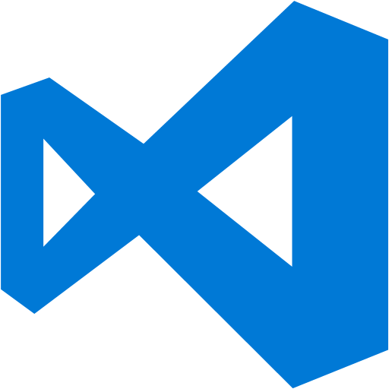
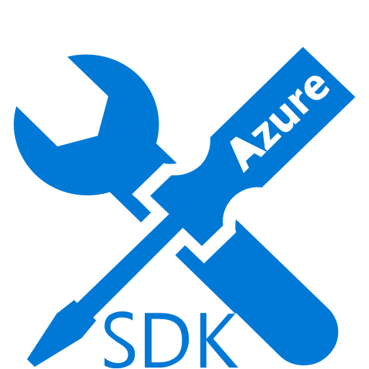
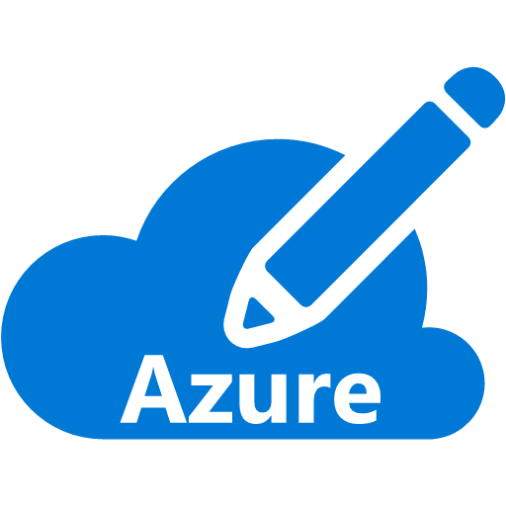
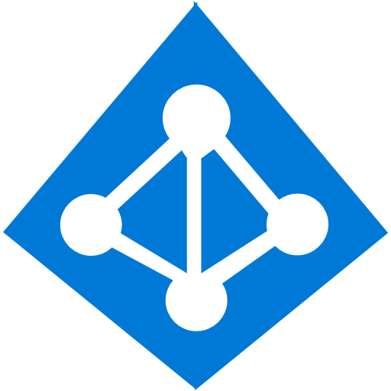
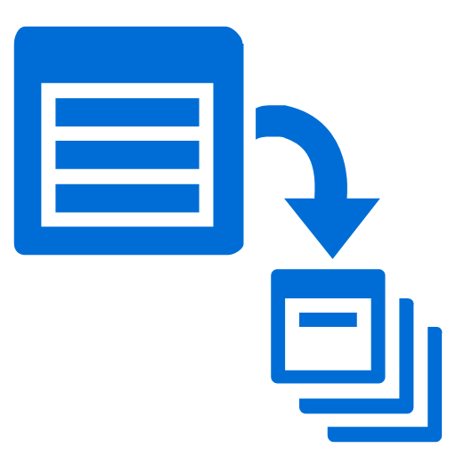

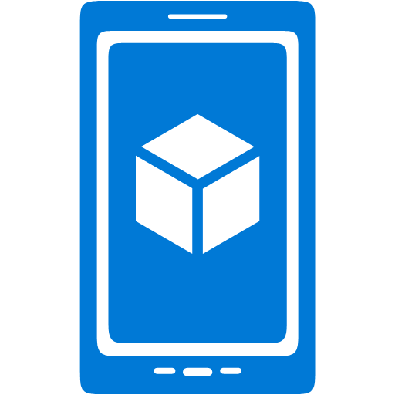





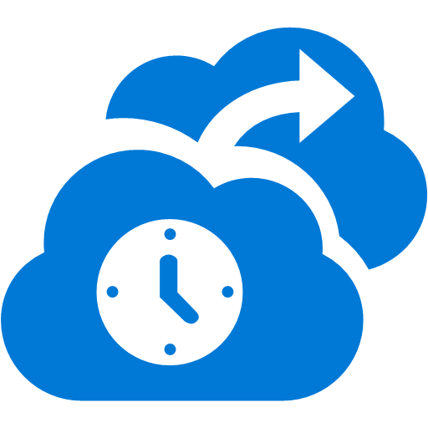

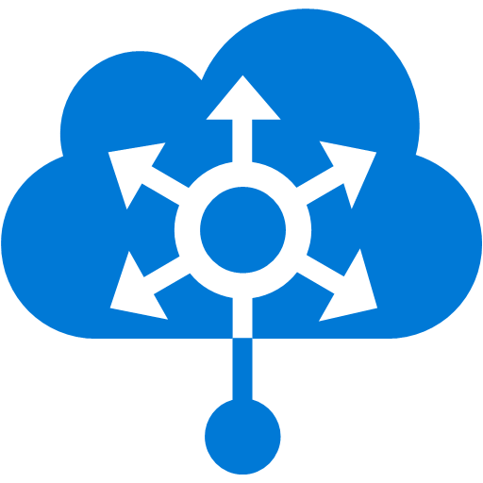



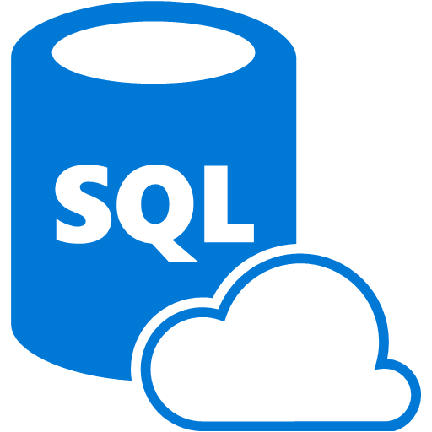


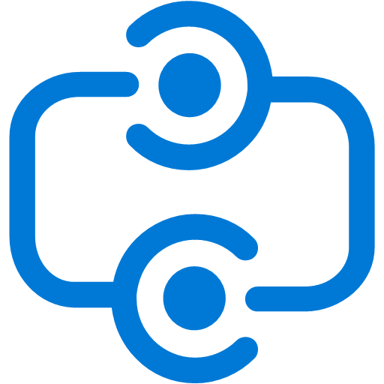


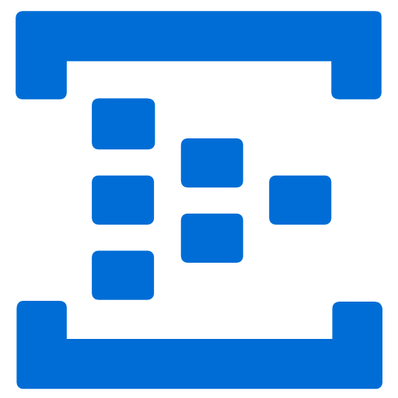

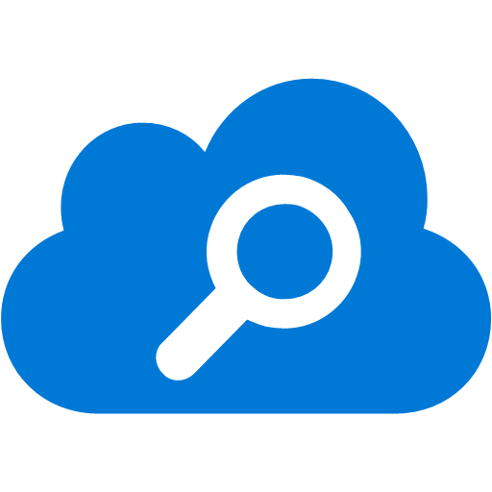
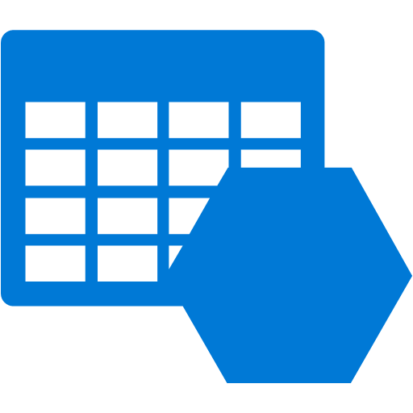

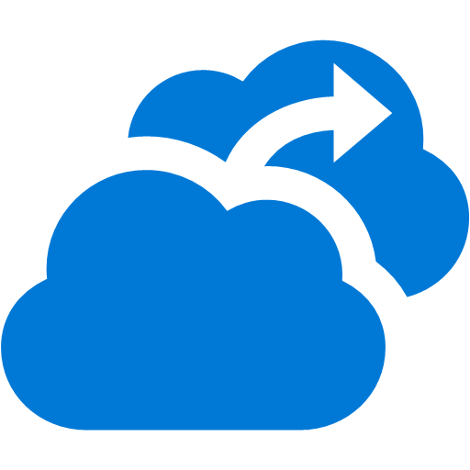



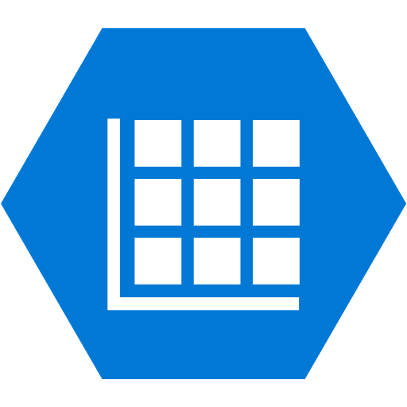
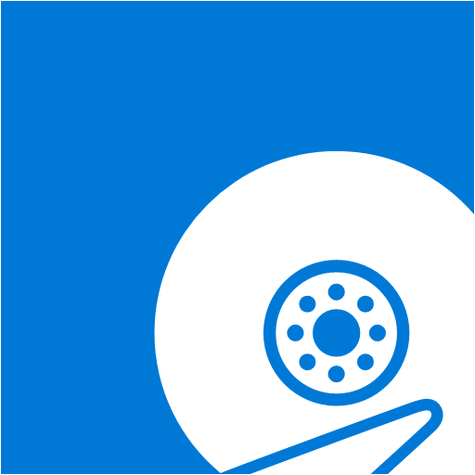



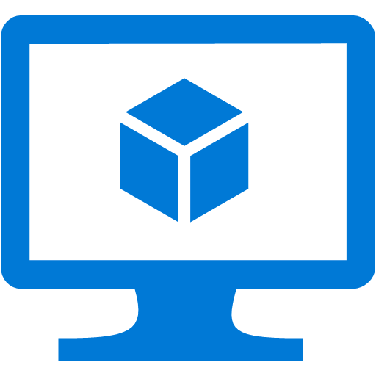
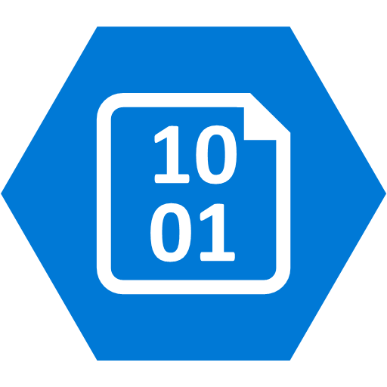
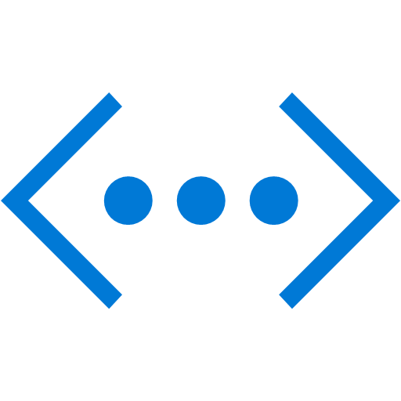
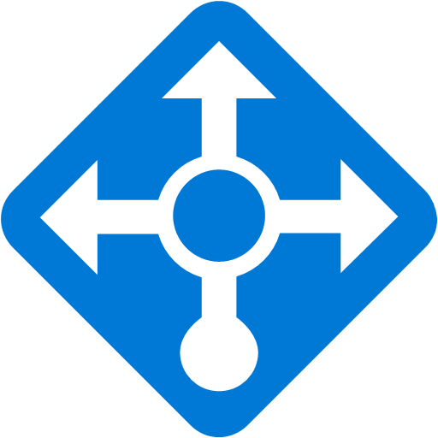
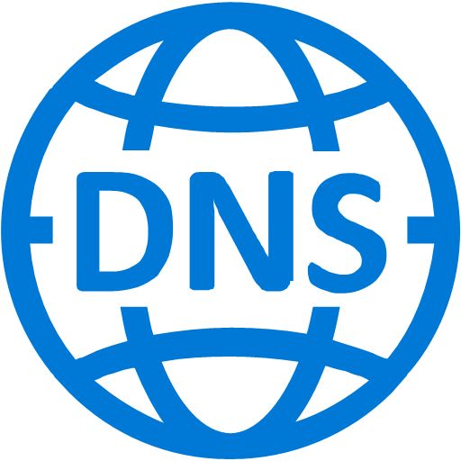
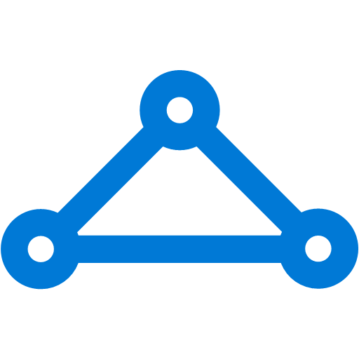


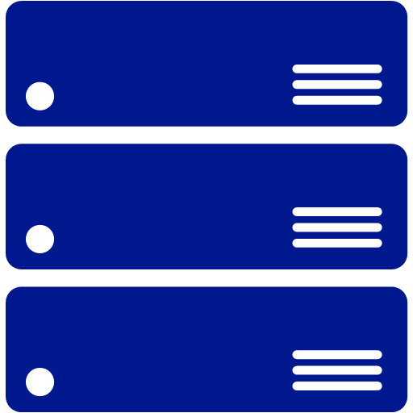
Platform Services
Security & Management
Compute
Web and Mobile
Developer Services
Hybrid
Operations
Cloud
Services
Service
Fabric
Web Apps
API
Apps
API
Management
Visual Studio
Azure SDK
Portal
Azure AD
Connect Health
Batch
Remote App
Mobile
Apps
Logic
Apps
Notification
Hubs
Team Project
Application
Insights
Active
Directory
AD Privileged
Identity
Management
Multi-Factor
Authentication
Integration
Analytics & IoT
Data
Backup
Storage
Queues
Biztalk
Services
Automation
HDInsight
Machine
Learning
SQL
Database
SQL Data
Warehouse
Operational
Insights
Hybrid
Connections
Service
Bus
Key Vault
Data
Factory
Event
Hubs
Redis
Cache
Search
Import/Export
Store /
Marketplace
Media & CDN
Site
Recovery
Stream
Analytics
Mobile
Engagement
DocumentDB
Tables
VM Image Gallery
& VM Depot
Media
Services
Content Delivery
Network (CDN)
StorSimple
Infrastructure Services
Compute
Storage
Networking
Virtual Machines
Containers
BLOB Storage
Azure Files
Premium Storage
Virtual Network
Load Balancer
DNS
Express
Route
Traffic Manager
VPN Gateway
Application Gateway
Datacenter Infrastructure (24 Regions, 19 Online)
Notes:
In previous sessions we’ve mostly discussed IaaS capabilities in Azure. We’ve barely touched the Platform Services yet, yet there are many, and these all help you build Modern Cloud Apps.

Slide 7
Platform Services
Security & Management
Compute
Web and Mobile
Developer Services
Hybrid
Operations
Cloud
Services
Service
Fabric
Web Apps
API
Apps
API
Management
Visual Studio
Azure SDK
Portal
Azure AD
Connect Health
Batch
Remote App
Mobile
Apps
Logic
Apps
Notification
Hubs
Team Project
Application
Insights
Active
Directory
AD Privileged
Identity
Management
Multi-Factor
Authentication
Integration
Analytics & IoT
Data
Backup
Storage
Queues
Biztalk
Services
Automation
HDInsight
Machine
Learning
SQL
Database
SQL Data
Warehouse
Operational
Insights
Hybrid
Connections
Service
Bus
Key Vault
Data
Factory
Event
Hubs
Redis
Cache
Search
Import/Export
Store /
Marketplace
Media & CDN
Site
Recovery
Stream
Analytics
Mobile
Engagement
DocumentDB
Tables
VM Image Gallery
& VM Depot
Media
Services
Content Delivery
Network (CDN)
StorSimple
Infrastructure Services
Compute
Storage
Networking
Virtual Machines
Containers
BLOB Storage
Azure Files
Premium Storage
Virtual Network
Load Balancer
DNS
Express
Route
Traffic Manager
VPN Gateway
Application Gateway
Datacenter Infrastructure (24 Regions, 19 Online)
Notes:
These Platform Services can be related to the logical functional blocks of a Modern Cloud App, and we’ll walk through these one by one. There is no 1-to-1 mapping, as some services have multiple capabilities that may fall into different functional blocks, but using the framing of a Modern Cloud App, it is easier to understand some of the functionality provided by Azure.

Slide 8
Modern Apps
Devices, Browsers, Things etc.
Response
Receive
Distribute
Process
Analyze
Store
Notes:
The Receive and Response block are very closely related and served using the same platform services. These are all about interfacing with clients such as browsers and devices.

Slide 9
Platform Services
Security & Management
Compute
Web and Mobile
Developer Services
Hybrid
Operations
Cloud
Services
Service
Fabric
Web Apps
API
Apps
API
Management
Visual Studio
Azure SDK
Portal
Azure AD
Connect Health
Batch
Remote App
Mobile
Apps
Logic
Apps
Notification
Hubs
Team Project
Application
Insights
Active
Directory
AD Privileged
Identity
Management
Multi-Factor
Authentication
Integration
Analytics & IoT
Data
Backup
Storage
Queues
Biztalk
Services
Automation
HDInsight
Machine
Learning
SQL
Database
SQL Data
Warehouse
Operational
Insights
Hybrid
Connections
Service
Bus
Key Vault
Data
Factory
Event
Hubs
Redis
Cache
Search
Import/Export
Store /
Marketplace
Media & CDN
Site
Recovery
Stream
Analytics
Mobile
Engagement
DocumentDB
Tables
VM Image Gallery
& VM Depot
Media
Services
Content Delivery
Network (CDN)
StorSimple
Infrastructure Services
Compute
Storage
Networking
Virtual Machines
Containers
BLOB Storage
Azure Files
Premium Storage
Virtual Network
Load Balancer
DNS
Express
Route
Traffic Manager
VPN Gateway
Application Gateway
Datacenter Infrastructure (24 Regions, 19 Online)
Notes:
Leaving IoT out for the moment, there are two main ways of interfacing. One is based on client app to services, the other is more about communication between services. In Web and Mobile you’ll find Web Apps, API Apps, Mobile, Apps, and Logic Apps, which are all part of App Service, and which we’ll look at in more detail. Besides that you also see API Management to expose your API’s to the outside world including documentation and the possibility to translate between different formats, and Notification Hubs to send messages in bulk to many devices.
Under Integration you can find Storage Queues and Service Bus. These provide you with endpoints you can expose to Apps, but also with a mechanism to store incoming messages and commands so they can be handled by processing logic. This enables you to throttle the incoming traffic and disconnect the actual processing from the reception of messages. The Integration block also contains Hybrid Connections and BizTalk Services, which are aimed at integrating your existing enterprise systems, potentially still in a local data center, which enables you to leverage existing functionality in Modern Cloud Apps in a robust way.

Slide 10

One Integrated Offering
Web Apps
Mobile Apps
Web apps that scale with your business
Build Mobile apps for any device
LOGIC Apps
API Apps
Automate business process across SaaS and on-premises
Easily build and consume APIs in the cloud
Notes:
The Azure App Service provides an integrated cloud platform for building modern enterprise applications across cloud and mobile devices. These applications are architected with flexibility in mind, easily scaling up or down to match the rhythm of your business.
The service is comprised of four components that share a common foundation. We’ll go into more detail shortly on Web Apps, Mobile Apps, Logic Apps, and API Apps.
For those who have used Azure Websites, Azure Mobile Services, or Azure Biz Talk Services in the past, these services have been rolled into one integrated offering with more consistent architecture, making it easier for an application to span between scenarios.

Slide 11
Full capability set available
.NET, Node.js, Java, PHP, and Python
WebJobs for long running tasks
Integrated VS publish, remote debug
Continuous integration
Auto-load balance, Autoscale
Site slots for staged deployments
Web Apps
Web apps run as-is
no changes required

Slide 12
Streamlining mobile experiences
Build native or cross platform applications
Connect to enterprise systems
Stay productive while offline
Rich push notification system
Mobile Apps
Mobile services plus
a whole lot more
Notes:
https://azure.microsoft.com/en-us/documentation/articles/app-service-mobile-value-prop-preview/
Mobile Apps is an entire platform for building and scaling enterprise grade mobile applications. It supports native applications for Windows Phone, iOS, and Android, and cross-platform apps build on Xamarin and Cordova. Regardless of platform, Mobile Apps helps solve common scenarios that have traditional been difficult to maintain with mobile apps – identity, offline, and push messaging. Users can be authenticated against a variety of identity providers, including AzureAD, Microsoft Accounts, Facebook, and more. What happens when users of your application are offline, or in an area of limited cell reception? Mobile Apps lights up a rich offline capability that allows users to go offline, then sync data back to the right systems when connectivity is restored. This feature works across a variety of data sources, including SQL, Table Storage, Mongo, or Document DB, and SaaS APIs including Office 365, Salesforce, and Dynamics. Finally, push messaging can be cumbersome to implement well. Each of the 3 major mobile ecosystems have their own processes and technologies for implementing messaging. Mobile Apps smooth over that process, helping you get messaging implemented quickly and smoothly.

Slide 13
New Logic Apps for easy automation
No code designer for rapid creation
Dozens of pre-built templates to get started
Out of box support for popular SaaS and on-premises apps
Use with custom API apps of your own
LOGIC Apps
Automate SaaS and
on-premises systems
Notes:
Logic Apps are an interesting new part of the Azure App Service. Such applications are “no code” solutions that are authored by dragging and dropping elements onto a design canvas. This empowers developers and IT pros alike to create useful integration workflows that solve a variety of needs. Want to replicate records from a line of business system back to a SQL database and notify the front desk via an email? Sent a SMS notification when a certain condition is met? Identify negative Tweets and post into a Slack channel? Logic apps can help each of these scenarios and more.
Workflows are initiated with a “trigger” event, such as a particular email, or a change in an Azure Storage account. Workflow steps then take place as “actions”, which operate against a series of “connectors” for data flow. To get going even more quickly, check out the numerous pre-built Logic app templates in the Azure Marketplace.
Have a need that cannot be met by an existing connector in the gallery? You can roll your own API App and integrate it into your Logic workflow.

Slide 14
Easily use cloud or custom APIs:
Create and publish custom, reusable APIs
Dozens of built-in APIs for popular SaaS
Visual Studio tooling with one click publish and remote debugging
Automatic client SDK generation for many languages
Api Apps
Create, consume and
host APIs more easily
Notes:
API Apps provide a rich platform and ecosystem for building, hosting, and consuming RESTful API’s in the cloud, and on-premises. Built in support for authentication helps handle the Oauth flow you, ensuring your user’s credentials are allowed via AzureAD. Integrating your API App with other API’s – both your own and 3rd party SaaS services – is handled with a well defined connector process. A gallery of commonly used connectors even exists to speed such integration activities. Finally, Visual Studio provides excellent tooling for creating, deploying, and managing your API’s. Since API apps are built on a common foundation as the other app service components, it is straightforward to consume API apps as steps within your Logic Apps for integration scenarios.

Slide 15
App Service Environments
Premium option for dedicated resources
Capable of very high scale
Enables isolation and secure network access
Notes:
App Service Environments are a premium option for the most demanding of application deployments. All of the compute resources in an App Service Environment are dedicated exclusively to a single subscription, and an App Service Environment can be configured with up to fifty (50) compute resources for exclusive use by a single application. These environments are composed of a front-end compute resource pool, with an additional one to three pools of worker compute resources.
These environments are deployed into a regional virtual network, allowing them to easily be connected to on-premises environments via a site-to-site VPN or ExpressRoute. Furthermore, the security features of vnets can be employed to harden applications. Network security group scan be employed to restrict inbound communications, or to run apps behind upstream devices such as firewalls.

Slide 16


Securing App Service Environments
Virtual Network
Subnet A
10.0.1.0/26
Subnet B
VIP
192.23.1.2
ASE
VIP
192.56.47.63
ASE
Inbound
Traffic
NSG
Regional
Network

Slide 17
App Service

Slide 18
Modern Apps
Devices, Browsers, Things etc.
Response
Receive
Distribute
Process
Analyze
Store
Notes:
Once messages are received they need to be processed. Typically this means grabbing a message from a queue, and processing the message, at which point there will likely be interaction with a storage system.

Slide 19
Platform Services
Security & Management
Compute
Web and Mobile
Developer Services
Hybrid
Operations
Cloud
Services
Service
Fabric
Web Apps
API
Apps
API
Management
Visual Studio
Azure SDK
Portal
Azure AD
Connect Health
Batch
Remote App
Mobile
Apps
Logic
Apps
Notification
Hubs
Team Project
Application
Insights
Active
Directory
AD Privileged
Identity
Management
Multi-Factor
Authentication
Integration
Analytics & IoT
Data
Backup
Storage
Queues
Biztalk
Services
Automation
HDInsight
Machine
Learning
SQL
Database
SQL Data
Warehouse
Operational
Insights
Hybrid
Connections
Service
Bus
Key Vault
Data
Factory
Event
Hubs
Redis
Cache
Search
Import/Export
Store /
Marketplace
Media & CDN
Site
Recovery
Stream
Analytics
Mobile
Engagement
DocumentDB
Tables
VM Image Gallery
& VM Depot
Media
Services
Content Delivery
Network (CDN)
StorSimple
Infrastructure Services
Compute
Storage
Networking
Virtual Machines
Containers
BLOB Storage
Azure Files
Premium Storage
Virtual Network
Load Balancer
DNS
Express
Route
Traffic Manager
VPN Gateway
Application Gateway
Datacenter Infrastructure (24 Regions, 19 Online)
Notes:
The Compute options in the Azure platform range from IaaS services to higher level services such as Cloud Services, Service Fabric, and Batch. The higher level services are shown in the Compute block.
The Azure compute capabilities were already discussed in the Compute session, and you could use Web Jobs part of Web Apps service discussed earlier to do some of the compute work. Which applies to your situation depends on the kind of processing you need. In a typical use case you would have a VM Scale Set or Cloud Service listen to the queue in which the front-end drops messages to be processed.

Slide 20
Modern Apps
Devices, Browsers, Things etc.
Response
Receive
Distribute
Process
Analyze
Store

Slide 21
Platform Services
Security & Management
Compute
Web and Mobile
Developer Services
Hybrid
Operations
Cloud
Services
Service
Fabric
Web Apps
API
Apps
API
Management
Visual Studio
Azure SDK
Portal
Azure AD
Connect Health
Batch
Remote App
Mobile
Apps
Logic
Apps
Notification
Hubs
Team Project
Application
Insights
Active
Directory
AD Privileged
Identity
Management
Multi-Factor
Authentication
Integration
Analytics & IoT
Data
Backup
Storage
Queues
Biztalk
Services
Automation
HDInsight
Machine
Learning
SQL
Database
SQL Data
Warehouse
Operational
Insights
Hybrid
Connections
Service
Bus
Key Vault
Data
Factory
Event
Hubs
Redis
Cache
Search
Import/Export
Store /
Marketplace
Media & CDN
Site
Recovery
Stream
Analytics
Mobile
Engagement
DocumentDB
Tables
VM Image Gallery
& VM Depot
Media
Services
Content Delivery
Network (CDN)
StorSimple
Infrastructure Services
Compute
Storage
Networking
Virtual Machines
Containers
BLOB Storage
Azure Files
Premium Storage
Virtual Network
Load Balancer
DNS
Express
Route
Traffic Manager
VPN Gateway
Application Gateway
Datacenter Infrastructure (24 Regions, 19 Online)
Notes:
Without data your application is typically useless, so data is foundational to any application. Applications are generating massive amounts of data. Both functional data and logging data that we can analyze to optimize usage and user experience. The types of data have impact on how we can store it. For instance, putting log data in a relational database is very expensive.
Azure provides many options for data storage, ranging from relational databases to simple table and file storage. Because these are all part of the platform, you can combine them in a single application and take advantage of each of the storage mechanisms.

Slide 22
Relational Databases
Two-dimensional rows/columns
Strongly typed column data
Declarative schema
Customer Table
CustomerName
Address
Telephone
Proven stability and security
Flexible query-ability, reporting
For when model is known; query unknown
Order Table
OrderNumber
CustomerName
ProductName
Product Table
ProductName
Quantity
Color
Variable data structure
Scaling out
Notes:
Golden standard
Still being taught widely
Proven stability and security
Cloud first -> RDBMS less suited -> No hyperscale
Scaling -> Sharding
Relational databases are sets of tables composed of rows and columns that have specific relationships amongst themselves. Columns have specific data types that work with primary and secondary keys for strong referential integrity. Schemas are decided upon early and declaratively managed via the well known structured query language (SQL).
RDBMS’ have been the golden standard of data persistence for decades. University students across the world are studying SQL commands this very moment, and modern business runs on top of these stable workhorses. The rich query-ability through SQL and granular security controls for rows and cells make relationship databases a great option, especially when the data structure is well understood and static over time.
However, in the world of cloud first applications we often run into issues with relationship databases. Schemas may change, meaning time consuming and complex ALTER statements. Most importantly, it takes time to piece together 5 tables into one unified result set, and when amplified by thousands of concurrent users we can have issues in a hyper-scale world. Traditionally we’ve scaled up such databases, but we can only go so large. Horizontal scaling out can be complex and difficult to achieve in these scenarios. While these databases are a known, proven approach they bring opportunities for enhancement with other persistence technologies.
Long term storage & reporting

Slide 23
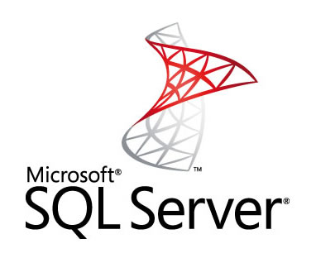
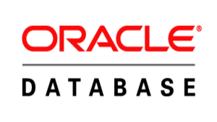
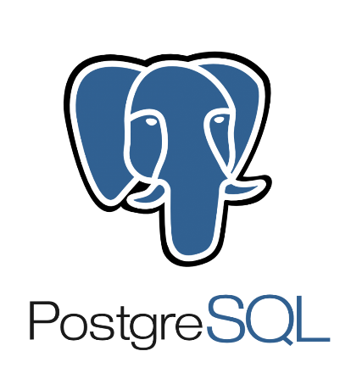
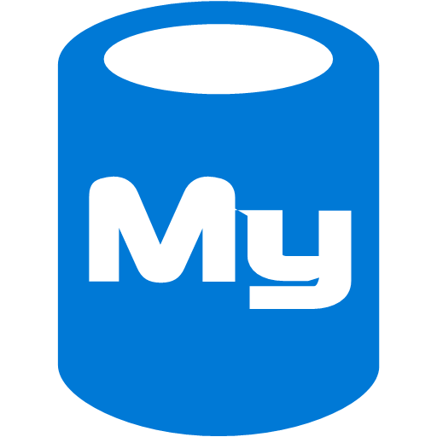
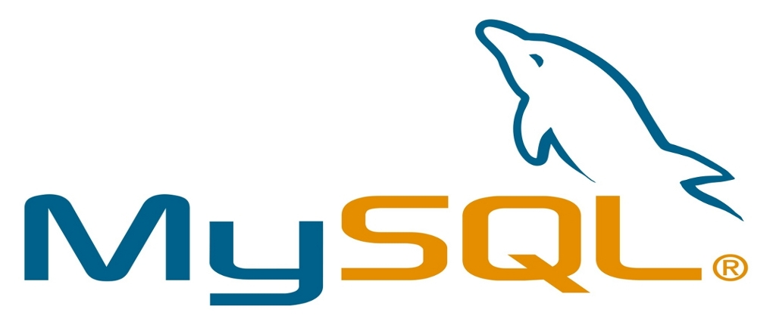
Relational Databases on Azure
PaaS
IaaS
Azure SQL Database
MySQL (via ClearDB)
Notes:
SQL Database up to 1 TB
ClearDB up to 1 TB

Slide 24
Key-Value Databases
Simple Map
Semi-Structured
De-normalized
Partition Key | Row Key | Value
Marketing | 00001 | Name | Age
 |  | Bob | 35
Marketing | 00002 | Name | Age
 |  | Karen | 42
Marketing | Department | Name | Count
 |  | MKTG | 104
Sales | 00010 | Name | Age
 |  | Sam | 29
Extremely fast
Scalable
For when you have & will query by the key
Interacting with indexes
Searching on properties within the Value
Complex queries
Notes:
https://azure.microsoft.com/en-us/documentation/articles/storage-table-design-guide/
Key Value databases are known for their simplistic mapping of a key, to a value. This semi-structured approach often results in de-normalized records, where records #1-10 look very different than #11-20. The biggest benefit to such simplicity is speed and enormous scalability. Large amounts of data can be served to large amounts of users in a performant, cost effective manner with key value databases. Such databases work best when you know the key and intend to query by the key.
Careful attention should be given to the indexes, otherwise much of the performance benefit is lost having to scan across multiple partitions to find results. Also, queries against particular data inside of the value is time intensive and difficult, especially with complex queries.
Key value databases allow for affordable, highly scalable solutions when performance is critical.

Slide 25

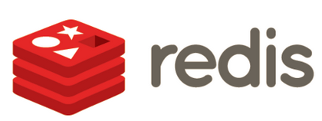


Key-Value Databases on Azure
PaaS
IaaS
Azure Table Storage
Azure Cache (Redis)

Slide 26
Document databases
No schema, no relationships
Collections of documents
Documents are JSON objects
{
"title": "Polo Long Sleeve Shirt",
"color": "red",
"material": "cotton"
}
{
"title": "NoSQL Distilled,
"author": [ "Martin Fowler", “P. Sadalage" ],
"isbn": "978-0321826626",
"pages": 192
}
Flexibility
Fast to get going
For when query is known, but structure is unknown
Complex relational data
Elaborate joins
Notes:
The name can be misleading, but document databases do not refer to Word or PDF documents. Instead, they are in reference to JavaScript Object Notation (“JSON”) documents. These schema-less, relationship-less documents are stored in much the same way as they are used in client applications. This consistent model makes for speed and flexibility, for developers spend less time focused on up front data model planning. The lack of a schema allows for agile changes to the model as an application’s requirements evolve. Document database are especially suited for scenarios where the types of needed queries are understood, but the underlying data is unknown or may change frequently.
The downside to such a database is that it can be troublesome to display complex relationship data in a world without schemas. Elaborate joins on such data may also be difficult and resource intensive. However, document databases are often a better choice than other approaches. Take a product catalog with very different products for example. A red cotton shirt would have very different columns than a paperback book in the world of relational databases. Many extra columns would be needed to accurately capture attributes, and nulls would abound in the dataset. However, document databases can easily adapt to wide varieties of attributes amongst very different products. Document databases have become very popular in recent years for this flexibility and ease of development.

Slide 27





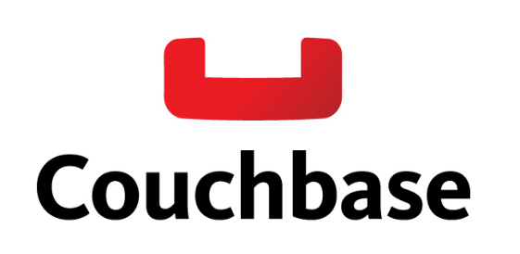

Document Databases on Azure
PaaS
IaaS
DocumentDB
RavenHQ
MongoLab

Slide 28
Graph Databases
Employee
Name: Sarah
Manages
Map-based
Relationships of Edges and Nodes
Works In
Works For
Employee
Network and relationship style applications
Social connections
Name: Walter
Department
Name: Marketing
Manages
Works For
Partitioning is problematic
Scale-up, not out
Works In
Employee
Name: Karen
Notes:
Graph databases do a terrific job at representing data by mapping the relationships of nodes and edges. You can see here that Sarah manages Walter, and that Sarah and Karen both work in the Marketing department. Little data is stored at each node, but this network of relationships is tremendously valuable. If you’ve ever used the Office Graph you can see how a graph works to surface connections between documents, users, and events.
What limits graph databases is horizontal scalability. Like relationship databases, graphs scale up far better than out. Partitioning data across multiple nodes may also be difficult.
Graphs are great for application features that rely on personalization or specialization. For example, in an ecommerce app the ability to suggest that “users who bought white bicycles also like to buy red shoes” is an example of where a graph database would be used.

Slide 29



Graph Databases on Azure
PaaS
IaaS
Azure AD
(Sort of)

Slide 30
Polyglot Persistence

Slide 31
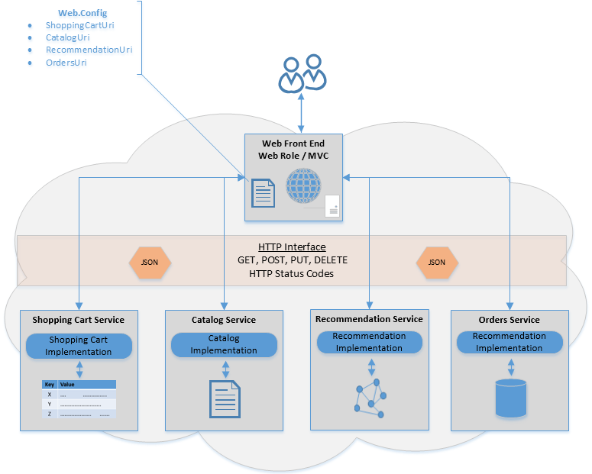
Repository Pattern
Notes:
The repository pattern is a technique to abstract and encapsulate data access logic away from the application and the actual database service layer. This interface allows for more flexibility in database choice. For example, when the data access is more loosely coupled with a repository pattern, the underlying database could be swapped out as an application matures. Perhaps you start with DocumentDB as your choice for a document database, but requirements change and a feature from MongoDB would be better suited for the application. With a properly configured repository pattern you can easily migrate and transition between data storage options with minimal interruption to the application tier. For polyglot persistence architectures such an abstraction layer decreases maintenance complexity of your applications.

Slide 32
Benefits of Polyglot Persistence
Use each database type for its strengths
Enhanced developer productivity
Improved data access performance
Notes:
Not forcing developers to force a round peg in a square hole. Trying to do relationship querying in a RDBMS would be a nightmare, whereas it’s a simple command in a graph DB.
Service encapsulation – ability to change underlying data type as needs evolve (start w DocDB, then decide you need MongoDB)
Using multiple databases is inherently more complex than a single database. However the advantages of having a good fit for each is a better overall solution.
As mentioned before, each type of database has a variety of pros and cons. Implementing polyglot persistence allows you to leverage the strengths while minimizing the weaknesses of different data persistence mechanisms. There are fewer instances of trying to fit a “square peg into a round hole” with scenarios such a product catalog. A catalog is difficult to achieve in a RDBMS, but fits nicely into the constructs of a document database.
Second, developers are empowered and more productive with polyglot persistence patterns. In the world of agile and scrum, it’s not always sufficient to say “we have 100% finished the data stage of our application”. Data requirements, schemas, and structures are prone to evolving and changing over the lifecycle of an application. Storing data in a complimentary persistence mechanism makes evolving data models more predictable and less time intensive. Such features allow a developer to focus on a compelling application experience and not wrestling with a persistence layer.
Finally, cloud applications operate at a tremendous scale. Focusing on scalability helps to ensure that these applications will maintain responsiveness and performance to users all over the world as app usage grows.
Polyglot persistence is not about only using NoSQL technologies, but instead encourages architectures that take advantage of all available tools.

Slide 33
Modern Apps
Devices, Browsers, Things etc.
Response
Receive
Distribute
Process
Analyze
Store

Slide 34
Platform Services
Security & Management
Compute
Web and Mobile
Developer Services
Hybrid
Operations
Cloud
Services
Service
Fabric
Web Apps
API
Apps
API
Management
Visual Studio
Azure SDK
Portal
Azure AD
Connect Health
Batch
Remote App
Mobile
Apps
Logic
Apps
Notification
Hubs
Team Project
Application
Insights
Active
Directory
AD Privileged
Identity
Management
Multi-Factor
Authentication
Integration
Analytics & IoT
Data
Backup
Storage
Queues
Biztalk
Services
Automation
HDInsight
Machine
Learning
SQL
Database
SQL Data
Warehouse
Operational
Insights
Hybrid
Connections
Service
Bus
Key Vault
Data
Factory
Event
Hubs
Redis
Cache
Search
Import/Export
Store /
Marketplace
Media & CDN
Site
Recovery
Stream
Analytics
Mobile
Engagement
DocumentDB
Tables
VM Image Gallery
& VM Depot
Media
Services
Content Delivery
Network (CDN)
StorSimple
Infrastructure Services
Compute
Storage
Networking
Virtual Machines
Containers
BLOB Storage
Azure Files
Premium Storage
Virtual Network
Load Balancer
DNS
Express
Route
Traffic Manager
VPN Gateway
Application Gateway
Datacenter Infrastructure (24 Regions, 19 Online)

Slide 35
Modern Apps
Devices, Browsers, Things etc.
Response
Receive
Distribute
Process
Analyze
Store

Slide 36
Platform Services
Security & Management
Compute
Web and Mobile
Developer Services
Hybrid
Operations
Cloud
Services
Service
Fabric
Web Apps
API
Apps
API
Management
Visual Studio
Azure SDK
Portal
Azure AD
Connect Health
Batch
Remote App
Mobile
Apps
Logic
Apps
Notification
Hubs
Team Project
Application
Insights
Active
Directory
AD Privileged
Identity
Management
Multi-Factor
Authentication
Integration
Analytics & IoT
Data
Backup
Storage
Queues
Biztalk
Services
Automation
HDInsight
Machine
Learning
SQL
Database
SQL Data
Warehouse
Operational
Insights
Hybrid
Connections
Service
Bus
Key Vault
Data
Factory
Event
Hubs
Redis
Cache
Search
Import/Export
Store /
Marketplace
Media & CDN
Site
Recovery
Stream
Analytics
Mobile
Engagement
DocumentDB
Tables
VM Image Gallery
& VM Depot
Media
Services
Content Delivery
Network (CDN)
StorSimple
Infrastructure Services
Compute
Storage
Networking
Virtual Machines
Containers
BLOB Storage
Azure Files
Premium Storage
Virtual Network
Load Balancer
DNS
Express
Route
Traffic Manager
VPN Gateway
Application Gateway
Datacenter Infrastructure (24 Regions, 19 Online)

Slide 37
Bringing applications together

Slide 38
SaaS + PaaS + IaaS = ☺
Each of the 3 work together for great apps
Balancing control vs. convenience
Don’t reinvent the wheel
Notes:
Cloud applications come in all shapes and sizes, and with Azure you have complete control over how facets of your application is architected. Your solution may not be 100% PaaS, nor 100% IaaS. Instead, we encourage you to make the best choice for your project’s need. Blending components together allows you to leverage the strengths of each particular approach, helping to achieve balance between control and convenience in your solution. Need to swap out a PaaS instance of SQL Database with MS SQL Server on IaaS VM’s? No problem! Want to simplify maintenance overhead by moving your Node.js application from a Ubuntu VM on IaaS over to a PaaS Web App? Go right ahead. There is immense freedom in mixing components as you see fit. Finally, nobody likes to reinvent the wheel. There are numerous services available today in a SaaS format that allow you to add functionality without complexity. Interacting with these services over API’s allow you to focus on the secret sauce of your application by minimizing time consuming boilerplate components. Great apps can work across each of three deployment methods.

Slide 39



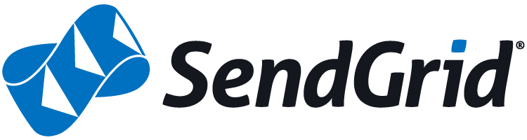
Common SaaS integrations
“I need to send a SMS messages”
“I need to accept credit cards”
“I need to send emails”
“I need to manage a distribution list”
Notes:
There are numerous scenarios where interacting with a SaaS provider may make more sense than building your own components. For example, many applications incorporate SMS messages sent to users’ mobile phones. Creating an entire SMS module for your application, if you don’t have experience in the nuances of SMS development, can be a significant challenge. This is where a company such as Twilio may make sense. They have already built out all of the pieces necessary to light up SMS features in applications – all you do is send a message to their API. This model extends beyond nice notifications into critical parts of applications such as payment processing. Setting up and maintaining an entire PCI compliant architecture stack is an extremely difficult task, especially if all you need to do is collect and mange credit card payments. Using a service such as Stripe allows you to take advantage of their hard work in setting up and managing a PCI compliant back end. There are also similar services for sending emails with Mailgun, managing distribution lists with MailChimp, and many more. In each of these scenarios you the architect can stand on the shoulders of these providers, leverage their expertise and infrastructure to decrease your time to market
Strip is PCI Compliant
https://support.stripe.com/questions/is-stripe-pci-compliant

Slide 40





Blended Architecture
AzureAD secured Web App (PaaS)
Database on Azure VM’s (IaaS)
SendGrid Email API (SaaS)
Notes:
In this basic example, a user is accessing a line of business application from their browser. After using their credentials to authenticate with AzureAD, they are able to access the web application deployed to an Azure Web App. This is an example of platform as a service, since both AzureAD and the Azure App Service are PaaS components. The line of business application is interacting with data stored in an Oracle Database. Such databases are deployed into virtual machines running on Azure, and represent an infrastructure as a service deployment. Finally, the application is sending notifications to the user via a 3rd party software as a service vendor named “SendGrid”. This SaaS provider means that separate infrastructure for an email server is not necessary. All three deployment approaches – PaaS, IaaS, and SaaS – work together to provide a great application experience.

Slide 41
Summary
Modern Apps use different principles/architecture
Azure provides many services you can leverage
Combine different services to leverage advantages
Use higher level third party services
Notes:
Distributed applications and service running in the cloud are, by their very nature, complex pieces of software that comprise many moving parts. In a production environment, it is important to be able to track the way in which users utilize your system, trace resource utilization, and generally monitor the health and performance of your system. This information can be used as a diagnostic aid to detect and correct issues, and also to help spot potential problems and prevent them from occurring.

